Slide 1
CS F415 Data Mining Topic: Data (Type, Datasets, Quality, Pre-processing, Similarity & Dissimilarity)
Dr. J Angel Arul Jothi
Department of Computer Science

Slide 2
Text Book Chapter 2

Slide 3
Data
Dataset: Collection of data objects and their attributes
An attribute is a property or characteristic of an object that vary from person to person or from time to time
Attribute is also known as variable, field, dimension, or feature
A collection of attributes describe an object
Object is also known as record, point, case, sample, entity, or instance
Attributes
Objects

Slide 4
Type of an Attribute
Properties of an attribute need not be the same as the properties of the values used to measure it
Example 1: Employee ID and Employee age represented as integers
ID has no limit but age has a maximum and minimum value
Average Employee age
Example 2: Mapping length of line segments to numbers in two different ways
An attribute can be measured in a way that does not capture all the properties of the attribute

Slide 5
Type of an Attribute
The way you measure an attribute sometimes may not capture all the properties of an attribute
Measurements on the right-hand side of the figure, capture both the ordering and additivity properties of the length attribute.
Whereas measurements on the left captures only the order property

Slide 6
Types of Attributes
There are four different types of attributes
Nominal
Names/Symbols/labels
Order is not emphasized
Examples: ID numbers, eye color, zip codes, gender
Ordinal – exhibits order
Ordering of values is logical
Usually used to get attitudes and perception
Difference between values – not logical
Examples: ratings (e.g., taste of potato chips on a scale from 1-5)

Slide 7
Types of Attributes
Interval
Numeric where order and difference between values is logical
Examples: calendar dates
Ratio
Values that have order, difference and ratio
Examples: age, mass, length, counts (years of experience)
Nominal and ordinal attributes are referred as categorical/qualitative attributes
Interval and ratio attributes are referred as quantitative or numeric attributes

Slide 8
Properties of Attribute Values
Properties of numbers used to describe attributes
Distinctness: = ≠
Order: < >
Addition: + -
Multiplication: * /
Nominal attribute: distinctness
Ordinal attribute: distinctness & order
Interval attribute: distinctness, order & addition
Ratio attribute: distinctness, order, addition and multiplication

Slide 9
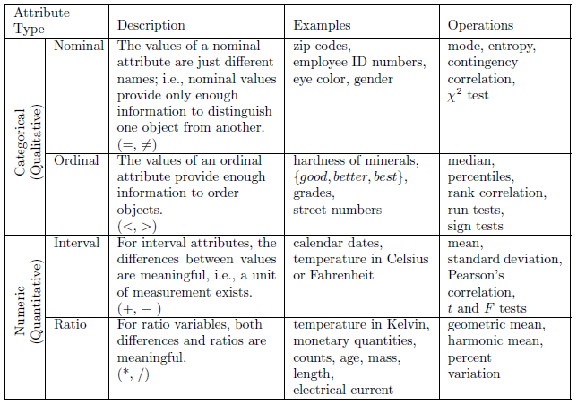
Types of Attributes

Slide 10
Discrete and Continuous Attributes (number of values)
Discrete Attribute
Has only a finite set of values or countably infinite values
Examples: zip codes, counts, ID numbers
Often represented as integer variables
Note: binary attributes are a special case of discrete attributes
Continuous Attribute
Has real numbers as attribute values
Examples: temperature, height, or weight
Continuous attributes are typically represented as floating-point variables

Slide 11
Asymmetric Attributes
For asymmetric attributes, only presence—a non-zero attribute value—is regarded as important
Example: Student course dataset, Market basket data
Binary attributes where only non-zero values are important are called asymmetric binary attributes
Asymmetric discrete attributes
Asymmetric continuous attributes

Slide 12
Important Characteristics of Data Sets
Dimensionality
Number of attributes in a dataset
Curse of Dimensionality: As dimension increases time and space requirements also increases. Hence, analysis is difficult
Dimensionality reduction techniques can be used
Sparsity
Many attributes have zero values
Analyze only attributes with non-zero values (Asymmetric attributes)
Saves computation time and storage

Slide 13
Important Characteristics of Data Sets
Resolution
Data can be obtained at different levels of resolution
Properties of data is different at different resolutions
Patterns depend on the level of resolution

Slide 14
Types of data sets
Record
Data Matrix
Sparse Data Matrix
Transaction/Market Data
Document term matrix
Graph
Data with relationships among objects
World Wide Web
Dataset with objects as graphs
Molecular Structures
Ordered
Sequential Data
Sequence Data
Time series Data
Spatial Data

Slide 15
Record Data
Data that consists of a collection of records, each of which consists of a fixed set of attributes without any relationship between the objects

Slide 16
Types of record data: Data Matrix
If data objects have the same fixed set of numeric attributes
The data objects can be thought of as points in a multi-dimensional space
where each dimension represents a distinct attribute
Such data set can be represented by an m by n matrix, where there are m rows, one for each object, and n columns, one for each attribute

Slide 17
Types of record data: Sparse Data Matrix
Example: Document-term matrix
A vocabulary is formed composed of all unique terms in the documents
Each document becomes a `term' vector
Each term is a component (attribute) of the vector
The value of each component in the vector is the number of times the corresponding term occurs in the document

Slide 18
Transaction/Market Data
A special type of record data
Each record (transaction) involves a set of items.
For example, consider a grocery store. The set of products purchased by a customer during one shopping trip constitute a transaction, while the individual products that were purchased are the items.

Slide 19
Graph Data
Examples: Generic graph and HTML Links
Data with relationships among objects
data objects are mapped to nodes
relationships among objects are captured by the links and link properties
Web pages on the World Wide Web as a directed graph
Node corresponds to a web page
Edge corresponds to a hyperlink
Hyperlink information can be used by search engines to fetch relevant pages

Slide 20
Chemical Data
Benzene Molecule: C₆H₆
Data with objects that are graphs
objects contain subobjects that have relationships
Example: structure of chemical compounds
nodes are atoms
links between nodes are chemical bonds
which substructures occur frequently in a set of compounds
ascertain whether the presence of any of these substructures is associated with the presence or absence of certain chemical properties
Carbon
Hydrogen

Slide 21
Ordered Data
The attributes have relationships that involve order in time or space

Slide 22
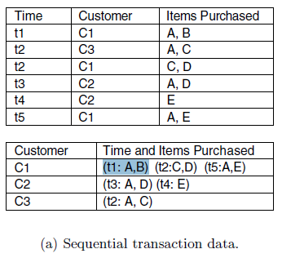
Ordered Data: Sequential data
Extension of record data, where each record has a time associated with it
Also called temporal data
Find patterns such as “candy sales peak before Halloween.”
Time can also be associated with each attribute
Find patterns such as “people who buy DVD players tend to buy DVDs in the period immediately following the purchase”

Slide 23
Ordered Data: Sequence data
Data set that is a sequence of individual entities
Genomic sequence data
predicting similarities in the structure and function of genes from similarities in nucleotide sequences

Slide 24
Ordered Data: Time series data
Each record is a time series, i.e., a series of measurements taken over time
Example: data set containing objects that are time series of the daily prices of various stocks

Slide 25
Ordered Data: Spatial data
Some objects have spatial attributes, such as positions or areas, as well as other types of attributes
Example of spatial data is weather data (precipitation, temperature, pressure) that is collected for a variety of geographical locations

Slide 26
Data Quality
Data may not be of good quality
Human error, limitations of measuring devices and flaws in the data collection process
Factors affecting data quality
Noise and artifacts
Outliers
Missing values
Inconsistent values
Duplicate data

Slide 27
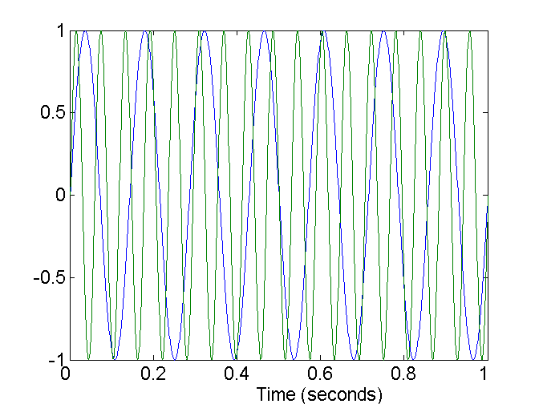
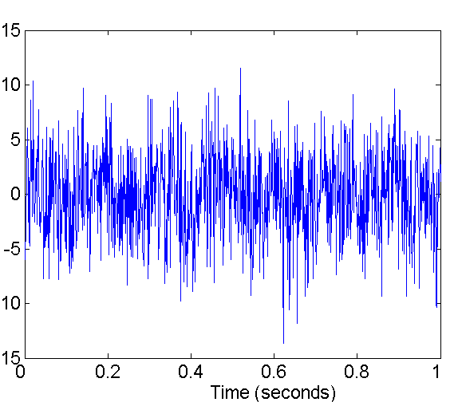
Noise
Noise is a random component of measurement error
Refers to unwanted signal that modifies (distorts) the original values/signals
Example: distortion of a person’s voice when talking on a poor phone
Two Sine Waves
Two Sine Waves + Noise

Slide 28
Artifacts
Deterministic distortion of data
Example: A streak in the same place in a set of photographs

Slide 29
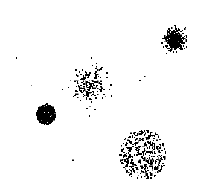
Outliers
Outliers are
Data objects with characteristics that are considerably different than most of the other data objects in the data set
Values of an attribute that are different from the usual values of the attribute
Outliers can be legitimate data objects or values
Outliers are of interest

Slide 30
Missing Values
Reasons for missing values
Information is not collected (e.g., people decline to give their age and weight)
Attributes may not be applicable to all objects (e.g., annual income is not applicable to children)
Handling missing values
Eliminate Data Objects or attributes
Estimate Missing Values – interpolation (time series data), average (continuous attribute), most common value (categorical attribute)
Ignore the Missing Value During Analysis

Slide 31
Handling missing values
Eliminate Data Objects with missing values
If many objects have missing values – reliable analysis is not possible
Good choice if the dataset has few objects with missing values
Eliminate attributes with missing values
Should be done with caution – the attribute might be critical for analysis

Slide 32
Handling missing values
Estimate Missing Values
Time series data where values vary in a smooth manner use interpolation
Dataset with many similar data points
Missing attribute value is continuous – replaced with the average of the nearest neighbors
Missing attribute value is categorical – replaced with the most frequently occurring value

Slide 33
Handling missing values
Ignore Missing Values
Example: Clustering a set of objects
Similarity is computed with attributes that do not have missing values
The similarity will be approximate

Slide 34
Inconsistent values
Example: Address details
Zip code and city are inconsistent
Person with age 50 weighs 5kg
Negative height values
Unavailable product code
Correction
Possible sometimes
Requires additional or redundant information

Slide 35
Duplicate Data
Data set may include data objects that are duplicates, or almost duplicates of one another
Major issue when merging data from heterogeneous sources
Examples:
Same person with multiple email addresses
Data deduplication or cleaning
Process of dealing with duplicate data
Correction requires additional or redundant information

Slide 36
Data Preprocessing
Data preprocessing steps are to be applied to the data to make it more suitable for data mining
Improves data mining analysis with respect to time, cost and quality

Slide 37
Data Preprocessing
Aggregation
Sampling
Feature Reduction (Dimensionality Reduction, Feature subset selection, Feature Weighting)
Feature creation
Discretization and Binarization
Attribute Transformation

Slide 38
Aggregation
Combining two or more objects into a single object
Purpose
Data reduction
Advantages
Small datasets
less memory/processing time
Change of scale
High level view of data instead of low level
More “stable” data
Aggregated data tends to have less variability
Disadvantage
Loss of details

Slide 39
Sampling
Sampling is the main technique employed for selecting a subset of data
Sampling is used in data mining because processing the entire data is too expensive or time consuming
The key principle for effective sampling is the following:
Using a sample will work almost as well as using the entire data set, if the sample is representative
A sample is representative if it has approximately the same property (of interest) as the original set of data

Slide 40
Types of Sampling
Simple Random Sampling
There is an equal probability of selecting any particular item
Sampling without replacement
As each item is selected, it is removed from the population
Sampling with replacement
Objects are not removed from the population as they are selected for the sample
In sampling with replacement, the same object can be picked up more than once
Simpler to analyse since the probability of selecting any object remains constant during the sampling process

Slide 41
Types of Sampling
Stratified sampling
Used when the dataset has different types of objects with different number of objects in each type
Random sampling can fail to represent objects that are less frequent
Example: Classifier model might not be able to learn the less frequent objects
How it is done?
Split the data into several partitions/groups based on the type of the objects and then draw equal number of random samples from each partition
In another variation, the number of objects drawn from each group is proportional to the size of that group

Slide 42
Types of Sampling
Progressive/Adaptive Sampling
Used when proper sample size can be difficult to determine
Start with a small sample, and then increase the sample size until a sample of sufficient size has been obtained
Evaluate the sample to judge if it is large enough
How it is done?
Suppose, for instance, that progressive sampling is used to learn a predictive model.
The accuracy of predictive models increases as the sample size increases, at some point the increase in accuracy levels off.
Stop increasing the sample size at this leveling-off point.

Slide 43
Feature Reduction
Reducing the number of features in a dataset
Purpose
More understandable models
Reduce amount of time and memory required by data mining algorithms
Allow data to be more easily visualized
May help to eliminate irrelevant features or reduce noise

Slide 44
Curse of Dimensionality
When dimension (attributes) increases, analysis become significantly harder
Data becomes increasingly sparse in the space that it occupies
Classification
Model not able to learn
Clustering and outlier detection
Definitions of distance between points, and density which is critical become less meaningful

Slide 45
Feature Reduction
Types:
Creating new attributes that are a combination of the old attributes
Dimensionality reduction
Selecting attributes that are a subset of the original attributes
Feature subset selection or feature selection
Dimensionality Reduction Techniques
Principle Component Analysis (PCA)
Singular Value Decomposition (SVD)

Slide 46
Dimensionality Reduction: PCA
Use techniques from linear algebra
Maps the data from a high-dimensional space into a lower-dimensional space
Continuous data
Finds new attributes (principal components) that
are linear combinations of the original attributes
are orthogonal (perpendicular) to each other
capture the maximum amount of variation in the data

Slide 47
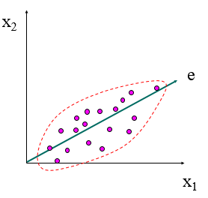
Dimensionality Reduction: PCA
Goal is to find a projection that captures the largest amount of variation in data

Slide 48
Feature Subset Selection
Use/Select only a subset of features
Eliminates redundant and irrelevant features
Redundant features
Duplicate
Much or all of the information is contained in one or more other attributes
Example: purchase price of a product and the amount of sales tax paid
Irrelevant features
Contain no information that is useful for the data mining task at hand
Example: Students' ID is often irrelevant to the task of predicting students' GPA

Slide 49
Feature Subset Selection
Techniques:
Brute-force approach
Try all possible feature subsets as input to data mining algorithm
n attributes is 2^{n}
Evaluation function

Slide 50
Feature Subset Selection
FS methods are classified into three types, based on the interaction with the learning model such as Filter, Wrapper and Embedded Methods
Filter approaches
Features are selected before the data mining algorithm is run
Features are selected using statistical measures that are independent of the DM algorithms
Information gain, chi-square test, fisher score, correlation coefficient

Slide 51
Filter methods
Filter methods use variable ranking techniques as the principle criteria for variable selection by ordering. Ranking methods are used due to their simplicity and good success is reported for practical applications. A suitable ranking criterion is used to score the variables and a threshold is used to remove variables below the threshold. Ranking methods are filter methods since they are applied before classification to filter out the less relevant variables. A basic property of a unique feature

Slide 52
Feature Subset Selection
Wrapper approaches
The best subset of features is selected based on the results of the predictive model (classifier/regressor)
Computationally more expensive than filter methods, due to the repeated learning steps and cross-validation
Recursive feature elimination, sequential feature selection algorithms (Sequential Forward Selection (SFS), Sequential Backward Selection (SBS))

Slide 53
Wrapper methods
Wrapper methods use the predictor as a black box and the predictor performance as the objective function to evaluate the variable subset. Since evaluating 2^{n} subsets becomes a NP-hard problem, suboptimal subsets are found by employing search algorithms which find a subset heuristically. A number of search algorithms can be used to find a subset of variables which maximizes the objective function which is the classification performance. The Branch and Bound method [8], [30] used tree structured

Slide 54
Feature Subset Selection
Embedded approaches
Feature selection occurs naturally as part of the data mining algorithm during its operation
The algorithm itself decides which attributes to use and which to ignore
Decision tree classifiers

Slide 55
An Architecture for Feature Subset Selection
A common architecture - filter and wrapper approaches
The feature selection process
a search strategy that controls the generation of a new subset of features
a measure for evaluating a subset
a stopping criterion
a validation procedure
Difference between filter methods and wrapper (evaluate a subset of features)
For a wrapper method, subset evaluation uses the target data mining algorithm, while for a filter approach, the evaluation technique is distinct from the target data mining algorithm

Slide 56
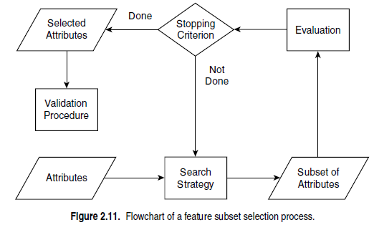
Feature subset selection process

Slide 57
Feature Weighting
Used to keep or eliminate features
Important features are assigned a higher weight
Less important features are given a lower weight
Weights are sometimes assigned based on domain knowledge about the relative importance of features

Slide 58
Feature Creation
Create new attributes that can capture the important information in a data set much more efficiently than the original attributes
The number of new attributes can be smaller than the number of original attributes
Three general methodologies
Feature Extraction
Mapping Data to New Space
Time series data to frequency domain
Feature Construction
Constructing new features from already existing ones
Density = mass/volume

Slide 59
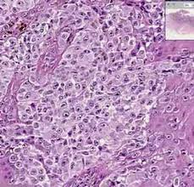
Feature Extraction
Histopathology image
Image data is processed to provide higher level features
Colour
Shape – area, diameter,
Texture

Slide 60
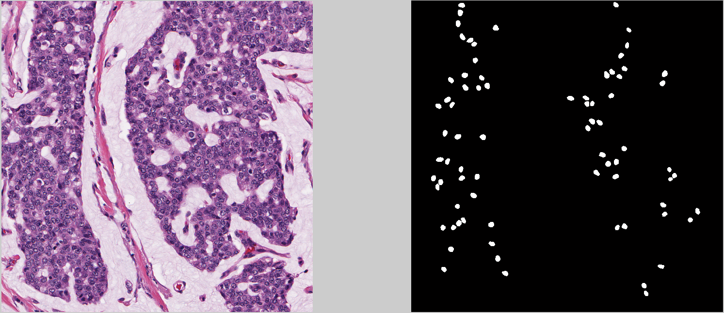
Image segmentation

Slide 61
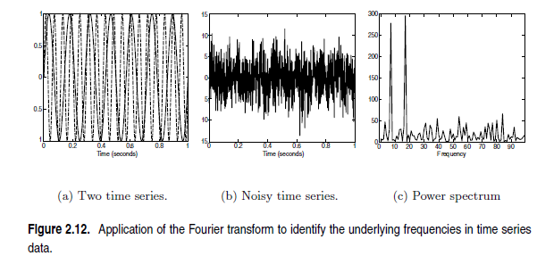
Mapping Data to New Space

Slide 62
Discretization and Binarization
Some data mining algorithms require that the data be in the form of
Categorical attributes (Classification algorithms)
Binary attributes (Association mining)
Discretization
Continuous attribute into a categorical attribute
Binarization
Continuous and discrete attributes into one or more binary attributes

Slide 63
Binarization
Binarizing categorical attribute (Method 1)
For each of the m categorical values, uniquely assign each original value to an integer in the interval [0, m − 1]
Convert each of these m integers to a binary number
n = ceil(log₂(m)) binary digits/attributes are required to represent these integers
Represent the binary numbers as n binary attributes

Slide 64
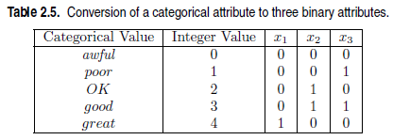
Binarization
Example

Slide 65
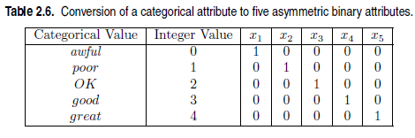
Binarization
Binarizing categorical attribute (Method 2)
Avoid unnecessary relationships by assigning one binary attribute for each categorical value

Slide 66
Discretization
Transformation of a continuous attribute to a categorical attribute
Two sub tasks
Step1: Deciding how many categories to have
Step2: Determining how to map the values of the continuous attribute to these categories
Step1
The values of the continuous attribute are sorted
Specify n−1 split points and divide the data into n intervals
Step2
All the values in one interval are mapped to the same categorical value

Slide 67
Discretization by equal width binning
Divides the range of the attribute into a user-specified number of intervals (bins) each having the same width
Bin width w = (max – min) / (no of bins)
Sort data for price (in dollars): 4, 8, 15, 21, 21, 24, 25, 28, 34
No. of bins = 3
Bin width w = 34-4 = 30/3 = 10
Bin1 (4-14)- 4, 8
Bin2(15-24)-15, 21, 21, 24,
Bin3(25-34)- 25, 28, 34
Note: Data should be in ascending order before performing equal width binning

Slide 68
Discretization by equal frequency binning
Put the same number of objects (frequency) into each interval
Sort data for price (in dollars): 4, 8, 15, 21, 21, 24, 25, 28, 34
Partition into (equal-frequency) bins of frequency 3
Bin 1: 4, 8, 15
Bin 2: 21, 21, 24
Bin 3: 25, 28, 34
Note: Data should be in ascending order before performing equal frequency binning

Slide 69
Attribute Transformation
Transformation applied to all values of an attribute/variable
Simple functions
Apply simple mathematical function to each value
If x is a variable then x^{k}, e^{x}, |x|, 1/x, √x, log(x)
Standardization or Normalization
Attribute values are scaled to fall within a smaller range, such as -1.0 to 1.0, or 0.0 to 1.0.
Avoid a variable with large values dominate the results of the calculation
Neural networks, nearest-neighbor classification

Slide 70

Min-max normalization
Let min_{A} and max_{A} are the minimum and maximum values of an attribute A
Min-max normalization maps a value, vi , of A to vi’ in the range [new_minA, new_maxA] by computing

Slide 71
Min-max normalization
Example:
Suppose that the minimum and maximum values for the attribute income are $12,000 and $98,000, respectively. Given income = $73,600, map it to the range [0.0,1.0] by min-max normalization
Solution:
((73,600-12,000/(98,000-12,000)) *(1.0-0)) + 0 = 0.716

Slide 72
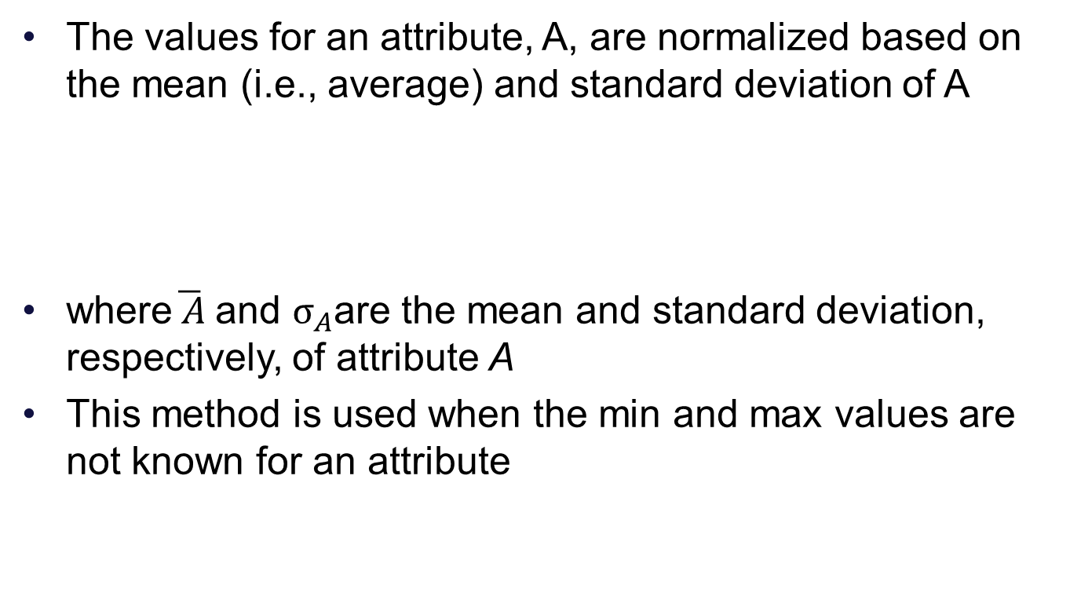

z-score normalization

Slide 73
z-score normalization
Example:
Suppose that the mean and standard deviation of the values for the attribute income are $54,000 and $16,000, respectively. Find the z-score normalized value for a original value of $73,600 for income
Solution:
73,600-54,000/16,000 = 1.225

Slide 74
Similarity and Dissimilarity
Similarity & Dissimilarity
Used by a number of data mining techniques
clustering, nearest neighbor classification, and anomaly detection
In many cases, the initial data set is not needed once these similarities or dissimilarities have been computed
Proximity refers to similarity or dissimilarity
Dense data (time series or n-dimensional points)
Correlation and Euclidean distance
Sparse data (document)
Jaccard and Cosine similarity measures

Slide 75
Similarity and Dissimilarity
Similarity
Numerical measure of how alike two data objects are
Is higher when objects are more alike
Dissimilarity
Numerical measure of how different two data objects are
Lower when objects are more alike

Slide 76
Transformations
Convert a similarity to a dissimilarity or vice versa
Transform a proximity measure to fall within a particular range, such as [0,1]
Proximity - Fixed range to [0, 1]
s’ = (s-s_min)/(s_max-s_min)
Proximity – (0 – infinity) to [0,1]
d’ = d/(1+d)
Transformation may change the meaning of the proximity measure
Example correlation (similarity measure) takes values in the range [-1. 1]. Mapping these values to the interval [0,1] by taking the absolute value loses information about the sign

Slide 77
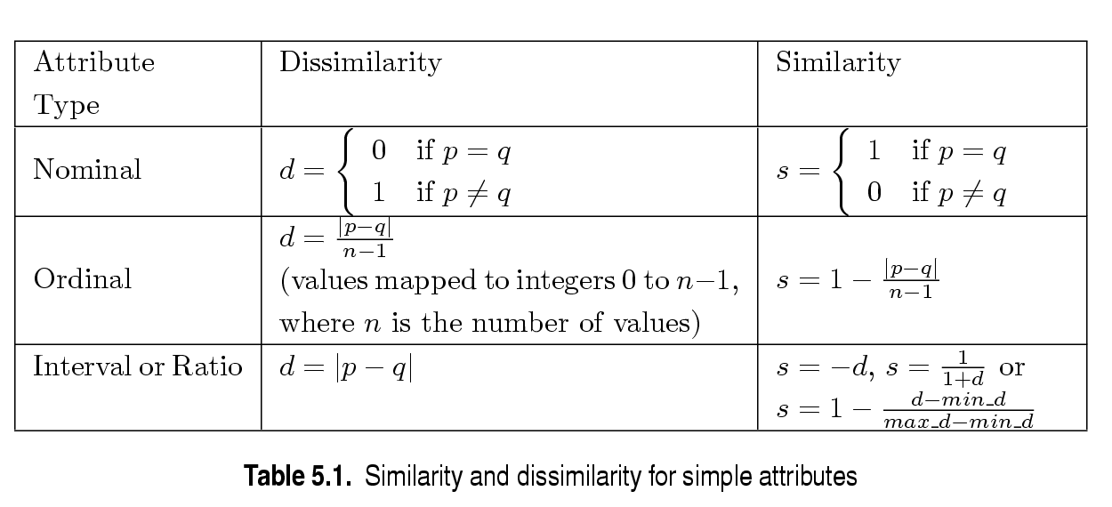
Similarity/Dissimilarity for Simple Attributes
p and q are the attribute values for two data objects

Slide 78
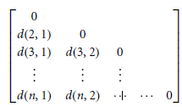
Dissimilarity matrix
Stores a collection of disimilarities for all pairs of n objects
Represented by an n-by-n table/matrix where n is the number of objects
d(i, j) is the dissimilarity or “difference” between objects i and j
d(i, j) is a non-negative number
d(i, j) = 0 means objects are highly similar
Note that d(i, i)=0; that is, the dissimilarity between an object and itself is 0
The matrix is symmetric, (i.e.,) d(i, j) = d (j, i)

Slide 79
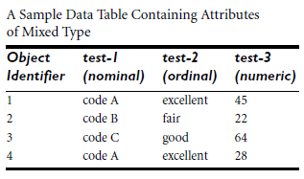
Example
Suppose that we have the sample data given below. Compute the dissimilarity matrix using the attribute, test-1
Dissimilarity matrix
test-1 | 1 | 2 | 3 | 4
1 | 0 | 1 | 1 | 0
2 | 1 | 0 | 1 | 1
3 | 1 | 1 | 0 | 1
4 | 0 | 1 | 1 | 0

Slide 80
Example
Suppose that we have the sample data given below. Compute the dissimilarity matrix using the attribute test-2
Dissimilarity matrix
test-2 | 1 | 2 | 3 | 4
1 | 0 | 1 | 0.5 | 0
2 | 1 | 0 | 0.5 | 1
3 | 0.5 | 0.5 | 0 | 0.5
4 | 0 | 1 | 0.5 | 0
Excellent (2), good (1), fair(0)

Slide 81
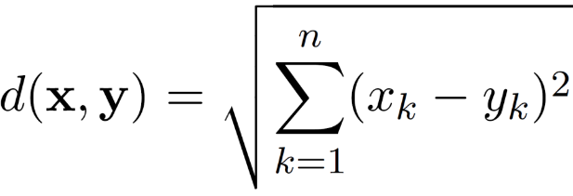
Dissimilarities between Data Objects
The Euclidean distance, d, between two points, x and y, in one-, two-, three-, or higher dimensional space, is given by the following formula
where n is the number of dimensions (attributes) and x_{k} and y_{k} are, respectively, the kth attributes (components) of data objects x and y
Standardization is necessary, if scales differ
The Euclidean distance is always greater than or equal to zero

Slide 82

Dissimilarities between Data Objects
Squared Euclidean Distance
The squared Euclidean distance, d, between two points, a and b, in one-, two-, three-, or higher dimensional space, is given by the following formula
where n is the number of dimensions (attributes) and x_{k} and y_{k} are, respectively, the kth attributes (components) of data objects x and y

Slide 83
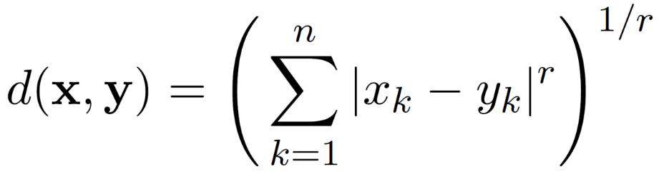
Minkowski Distance
Minkowski distance is a generalization of Euclidean distance
Where r is a parameter, n is the number of dimensions (attributes) and x_{k} and y_{k} are, respectively, the k^{th} attributes (components) of data objects x and y

Slide 84
Minkowski Distance: Examples
r = 1. City block (Manhattan, taxicab, L₁ norm) distance
d(x,y)= |x1 – y1| + |x2- y2| + … +|xn-yn|
The City block distance is always greater than or equal to zero
r = 2. Euclidean distance or L₂ norm
d(x,y)= (|x1 – y1|² + |x2- y2|² + … +|xn-yn|²)^{1/2}
r → ∞. “supremum” (L_{max} norm, L∞ norm) distance
This is the maximum difference between any component of the vectors
d(x,y) = max {|x1 – y1|, |x2- y2|, … ,|xn-yn|}

Slide 85
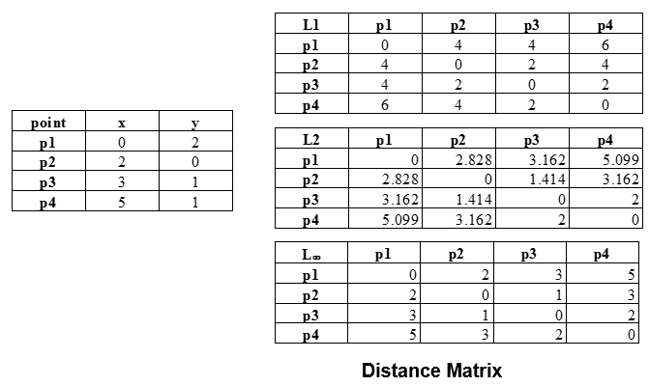
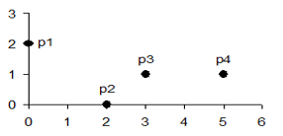
Minkowski Distance

Slide 86
Common Properties of a Distance
Distance is often used to refer to dissimilarities
Non negativity/Positivity:
d(p, q) ≥ 0 for all p and q and d(p, q) = 0 only if p = q
Symmetry:
d(p, q) = d(q, p) for all p and q
Triangle inequality:
d(p, r) ≤ d(p, q) + d(q, r) for all points p, q, and r
A distance that satisfies these properties is a metric

Slide 87
Similarities between Data Objects
Similarities, also have some well known properties.
s(p, q) = 1 (or maximum similarity) only if p = q.
s(p, q) = s(q, p) for all p and q. (Symmetry)
where s(p, q) is the similarity between points (data objects), p and q

Slide 88
Similarity Between Binary Vectors
Similarity between binary objects is called as similarity co-efficient
Let objects, p and q, have n binary attributes
Define the following quantities
M₀₁ = the number of attributes where p is 0 and q is 1
M₁₀ = the number of attributes where p is 1 and q is 0
M₀₀ = the number of attributes where p is 0 and q is 0
M₁₁ = the number of attributes where p is 1 and q is 1
Simple Matching and Jaccard Coefficients
SMC = number of matches / number of attributes
= (M₁₁ + M₀₀) / (M₀₁ + M₁₀ + M₁₁ + M₀₀)
J = number of 11 matches / number of not-both-zero attributes values
= (M₁₁) / (M₀₁ + M₁₀ + M₁₁)

Slide 89
SMC and Jaccard: Example
Compute SMC and Jaccard co-efficient for two data objects p and q
p = 1 0 0 0 0 0 0 0 0 0
q = 0 0 0 0 0 0 1 0 0 1

Slide 90
SMC and Jaccard: Solution
p = 1 0 0 0 0 0 0 0 0 0
q = 0 0 0 0 0 0 1 0 0 1
M₀₁ = 2 (the number of attributes where p is 0 and q is 1)
M₁₀ = 1 (the number of attributes where p is 1 and q is 0)
M₀₀ = 7 (the number of attributes where p is 0 and q is 0)
M₁₁ = 0 (the number of attributes where p is 1 and q is 1)
SMC = (M₁₁ + M₀₀)/(M₀₁ + M₁₀ + M₁₁ + M₀₀) = (0+7) / (2+1+0+7) = 0.7
J = (M₁₁) / (M₀₁ + M₁₀ + M₁₁) = 0 / (2 + 1 + 0) = 0

Slide 91
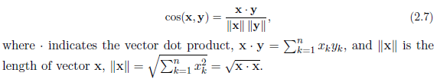
Cosine Similarity
If x and y are two document vectors, then
The cosine similarity ranges from +1 to -1
+1 is the highest similarity
complete opposite points have similarity -1

Slide 92
Cosine Similarity
If the cosine similarity is 1
The angle between x and y is 0◦
x and y are the same except for magnitude
If the cosine similarity is 0
The angle between x and y is 90◦
If the cosine similarity is -1
The angle between x and y is 180◦

Slide 93
Cosine Similarity: Example
Compute the cosine similarity between two document vectors d1 and d2
d₁ = 3 2 0 5 0 0 0 2 0 0
d₂ = 1 0 0 0 0 0 0 1 0 2

Slide 94
Cosine Similarity: Solution
d₁ = 3 2 0 5 0 0 0 2 0 0
d₂ = 1 0 0 0 0 0 0 1 0 2
d₁ • d₂= 3*1 + 2*0 + 0*0 + 5*0 + 0*0 + 0*0 + 0*0 + 2*1 + 0*0 + 0*2 = 5
||d₁|| = (3*3+2*2+0*0+5*5+0*0+0*0+0*0+2*2+0*0+0*0)^{0.5} = (42) ^{0.5} = 6.481
||d₂|| = (1*1+0*0+0*0+0*0+0*0+0*0+0*0+1*1+0*0+2*2) ^{0.5} = (6) ^{0.5} = 2.245
cos( d₁, d₂ ) = .3150

Slide 95
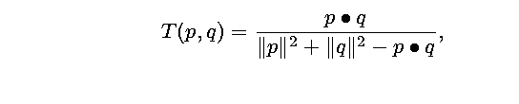
Extended Jaccard Coefficient (Tanimoto)
Used for finding similarity between documents (data)
Reduces to Jaccard co-efficient for binary attributes
Compute the Extended Jaccard Similarity between d1 and d2
d1 = 1 0 1 0 1 and d2 = 1 1 1 0 1
d1 = 1 1 1 1 1 and d2 = 1 1 1 1 1

Slide 96
Extended Jaccard Coefficient (Tanimoto)
Solution
d1 = 1 0 1 0 1
d2 = 1 1 1 0 1
d1.d2 = 3
||d1||² = 1 + 1 + 1 = 3
||d2||² = 1 + 1 + 1 + 1 = 4
T(d1, d2) = 3 / 3 + 4 – 3
T(d1, d2) = ¾ = 0.75

Slide 97
Extended Jaccard Coefficient (Tanimoto)
Solution
d1 = 1 1 1 1 1
d2 = 1 1 1 1 1
d1.d2 = 5
||d1||² = 1 + 1 + 1 + 1 + 1 = 5
||d2||² = 1 + 1 + 1 + 1 + 1 = 5
T(d1, d2) = 5 / 5 + 5 – 5
T(d1, d2) = 1

Slide 98
Correlation
Correlation coefficient also known as Pearson’s coefficient (r)
Numeric attributes
Measures linear relationship between objects
Value is between -1 and +1
If Correlation coefficient (A,B) > 0
Attributes A and B are positively correlated, meaning that the values of A increase as the values of B increase
The higher the value, the stronger the correlation hence, a higher value may indicate that A (or B) may be removed as a redundancy

Slide 99
Correlation
If Correlation coefficient (A,B) = 0
Attributes A and B are independent and there is no correlation between them
If Correlation coefficient (A,B) < 0
Attributes A and B are negatively correlated, where the values of one attribute increase as the values of the other attribute decrease
Each attribute discourages the other

Slide 100
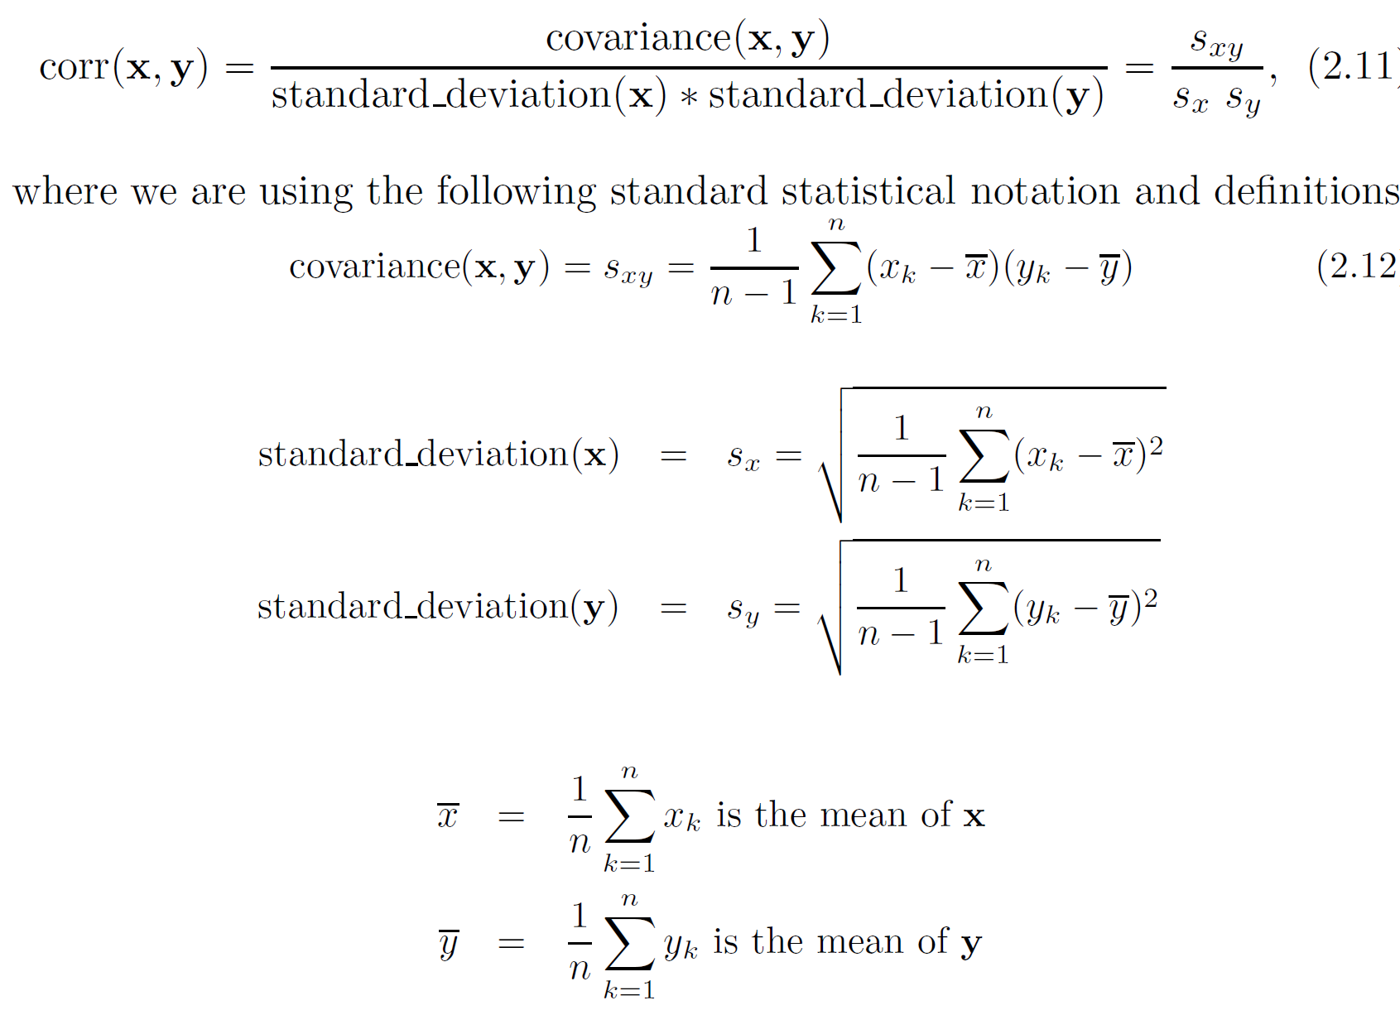
Correlation

Slide 101
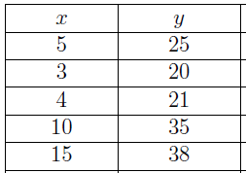
Correlation: Example
The time x in years that an employee spent at a company and the employee's hourly pay, y, for 5 employees are listed in the table. Calculate and interpret the correlation coefficient r.

Slide 102
Correlation: Solution
x | y | x-x* | y-y* | (x-x*) (y-y*) | (x-x*)² | (y-y*)²
5 | 25
3 | 20
4 | 21
10 | 35
15 | 38
Sum = 37 | Sum =139
Average (x) = 7.4
Average (y) = 27.8

Slide 103
Correlation: Solution
x | y | x-x* | y-y* | (x-x*) (y-y*) | (x-x*)² | (y-y*)²
5 | 25 | -2.4
3 | 20 | -4.4
4 | 21 | -3.4
10 | 35 | 2.6
15 | 38 | 7.6
Sum = 37 | Sum =139

Slide 104
Correlation: Solution
x | y | x-x* | y-y* | (x-x*) (y-y*) | (x-x*)² | (y-y*)²
5 | 25 | -2.4 | -2.8
3 | 20 | -4.4 | -7.8
4 | 21 | -3.4 | - 6.8
10 | 35 | 2.6 | 7.2
15 | 38 | 7.6 | 10.2
Sum = 37 | Sum =139

Slide 105
Correlation: Solution
x | y | x-x* | y-y* | (x-x*) (y-y*) | (x-x*)² | (y-y*)²
5 | 25 | -2.4 | -2.8 | 6.72
3 | 20 | -4.4 | -7.8 | 34.32
4 | 21 | -3.4 | - 6.8 | 23.12
10 | 35 | 2.6 | 7.2 | 18.72
15 | 38 | 7.6 | 10.2 | 77.52
Sum = 37 | Sum =139 |  |  | Sum = 160.4

Slide 106
Correlation: Solution
x | y | x-x* | y-y* | (x-x*) (y-y*) | (x-x*)² | (y-y*)²
5 | 25 | -2.4 | -2.8 | 6.72 | 5.76
3 | 20 | -4.4 | -7.8 | 34.32 | 19.36
4 | 21 | -3.4 | - 6.8 | 23.12 | 11.26
10 | 35 | 2.6 | 7.2 | 18.72 | 6.76
15 | 38 | 7.6 | 10.2 | 77.52 | 57.76
Sum = 37 | Sum =139 |  |  | Sum = 160.4 | Sum=101.2

Slide 107
Correlation: Solution
x | y | x-x* | y-y* | (x-x*) (y-y*) | (x-x*)² | (y-y*)²
5 | 25 | -2.4 | -2.8 | 6.72 | 5.76 | 7.84
3 | 20 | -4.4 | -7.8 | 34.32 | 19.36 | 60.84
4 | 21 | -3.4 | - 6.8 | 23.12 | 11.26 | 46.24
10 | 35 | 2.6 | 7.2 | 18.72 | 6.76 | 51.84
15 | 38 | 7.6 | 10.2 | 77.52 | 57.76 | 104.04
Sum = 37 | Sum =139 |  |  | Sum = 160.4 | Sum=101.2 | Sum =270.8
Average (x) = 7.4
Average (y) = 27.8
Sx= (101/4)^{1/2} = 5.02
Sy= (270.8/4)^{1/2} = 8.23
Covariance(x,y) = 160.4/4 = 40.1
Correlation(x,y) = 40.1/ (5.02) (8.23) = 0.97

Slide 108
Correlation: Solution
There is a strong positive correlation between the number of years the employee has worked and the employee's salary, since r is very close to 1.

Slide 109
Thank you

